Slide 1
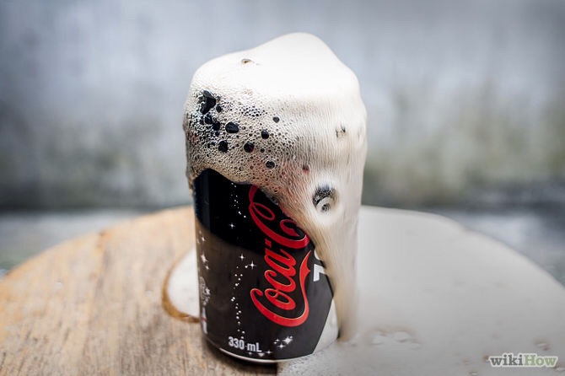
“Seeing” at the Nanoscale: Small X-ray Deflections off Nanoscopic Bubbles Can Teach Us How They Form
Andy Ylitalo
June 7, 2019

Slide 2
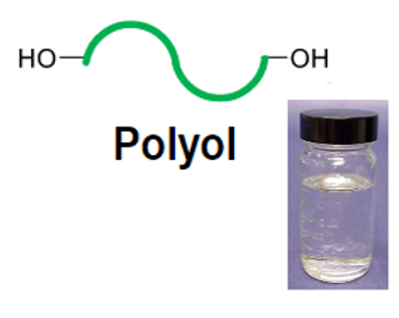
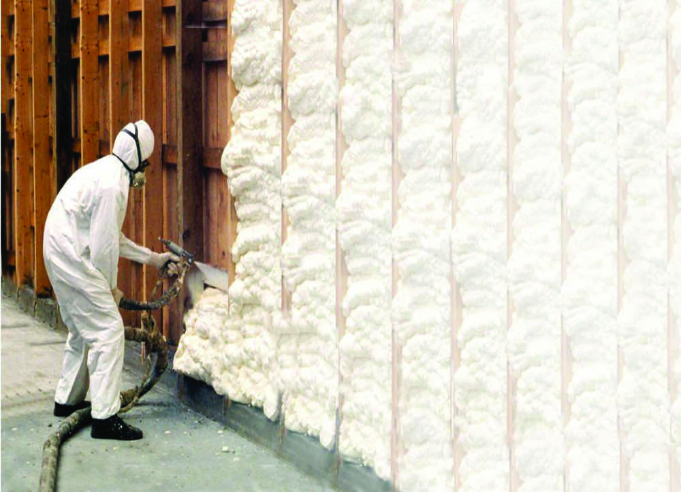
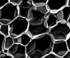
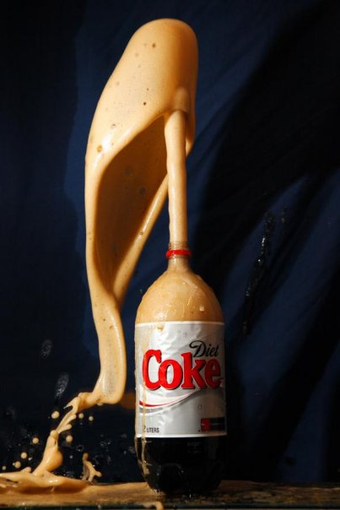
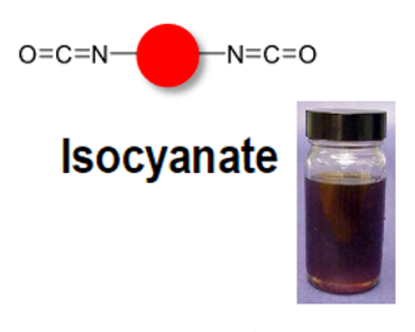
Motivation
Images courtesy of Dow Chemical Co.
Image Courtesy of Dow Chemical Co.
A
B
500 µm
Why do we want to study nucleation and early-stage growth of bubbles in polyurethane foams?
Notes:
Specifically interested in PU insulation formed from polyol and isocyanate for building insulation and how the early stages of nucleation and growth affect the final foam structure.

Slide 3
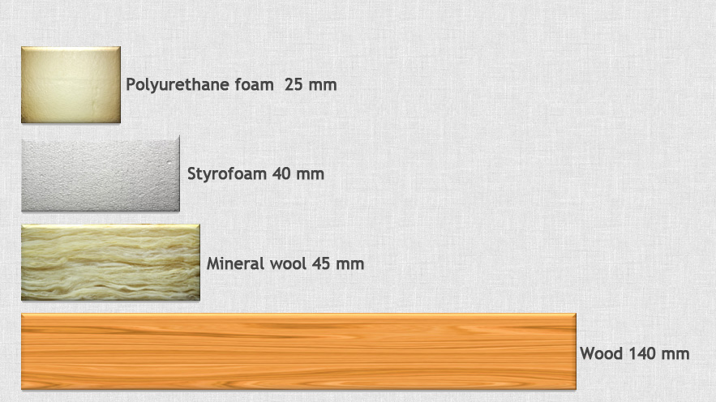
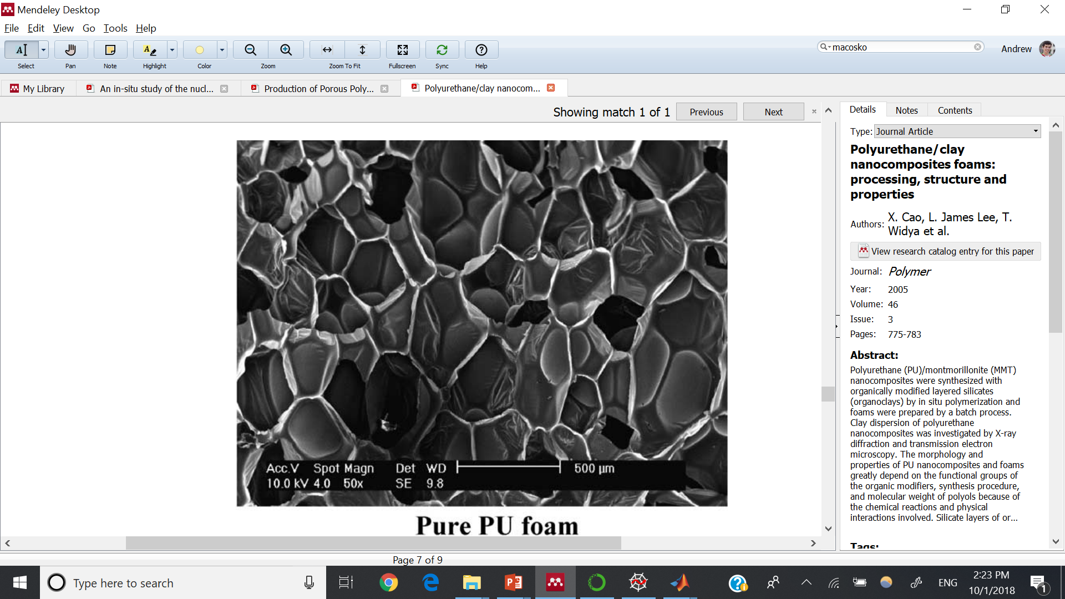
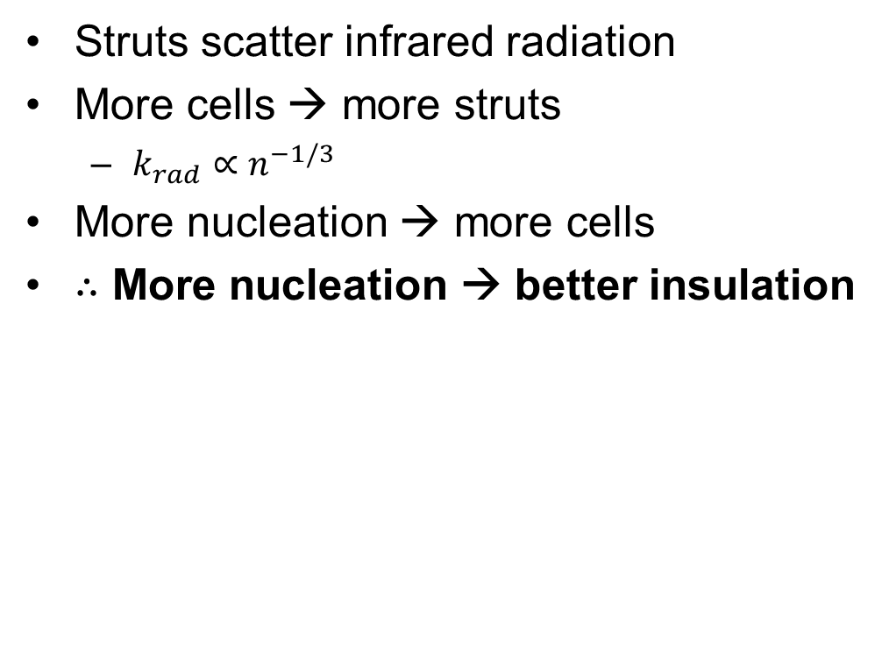
Improve PU Insulation by Nucleating More Bubbles
Equal Heat Flux
Heat Transfer in Foam
Polyurethane Foam 25 mm
Styrofoam 40 mm
Solid cond.
Gas cond.
Mineral Wool 45 mm
Rad.
Wood 140 mm
10x cells
www.izolacje-frel.pl
Polyurethane (PU) foam is best insulation of mass-produced materials
20-30% of heat transfer through PU is from radiation (IR)
Strut
Struts scatter infrared radiation
More cells → more struts
$k_{rad}∝n^{−1/3}$
More nucleation → more cells
$∴$ More nucleation → better insulation
500 μm
Cao, X. et al. 2005, Polymer 46, 775-783
Notes:
Detailed understanding of bubble nucleation in polyurethane foaming can help produce better polyurethane insulation. Because polyurethane is the best insulation among mass-produced materials, even a modest improvement would be unprecedented.
For scale, producing 10x more cells reduces the heat transfer through polyurethane foams by 10%. Further reduction in heat transfer can be achieved by nucleating enough bubbles to produce a nanofoam with cells smaller than 100 nm, at which point gas conduction is limited by Knudsen diffusion.
In addition to its academic importance, understanding bubble nucleation in polyurethane can be applied to producing unprecedented thermal insulation. Polyurethane insulating foam has the lowest thermal conductivity among mass-produced materials, so low that radiative heat transfer accounts for 20-30% of transmitted heat. By understanding how to maximize nucleation of bubbles in polyurethane foams, more cells can be produced in the final product, which results in more struts between cells, which reduce radiative heat transfer since struts are responsible for scattering infrared radiation in the foam. As result, the thermal conductivity k of radiative heat transfer is inversely proportional to the number density of cells to the 1/3 power. From this relationship, it turns out that by producing 10 times as many cells in the foam, the total thermal conductivity can be reduced by 10%. Every cell must come from at least one nucleation event.

Slide 4
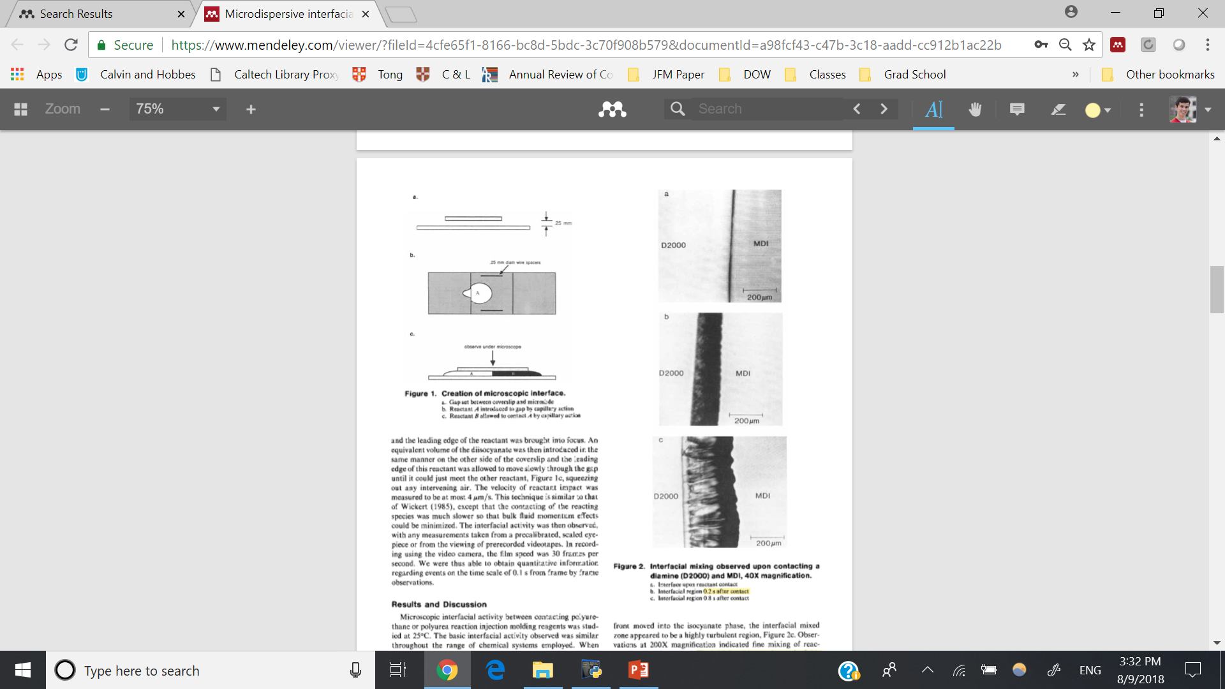
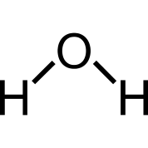
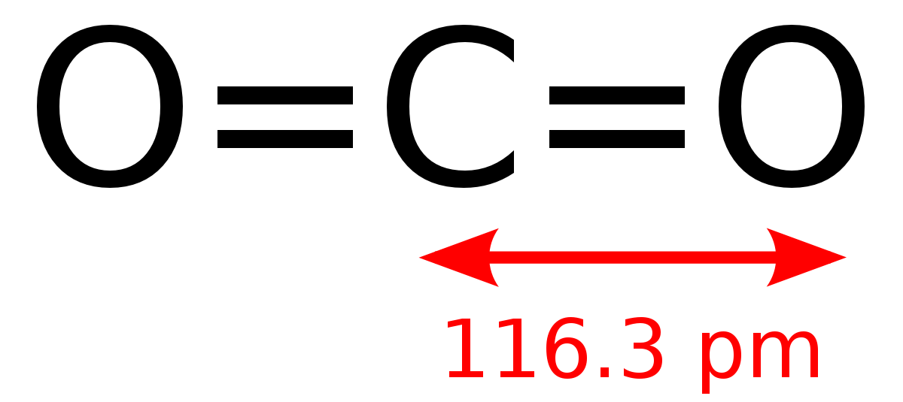
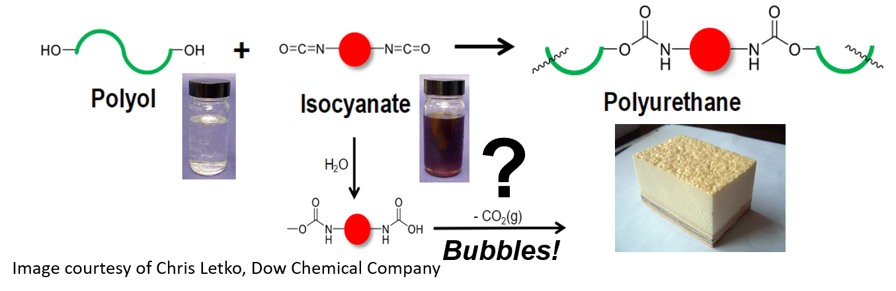

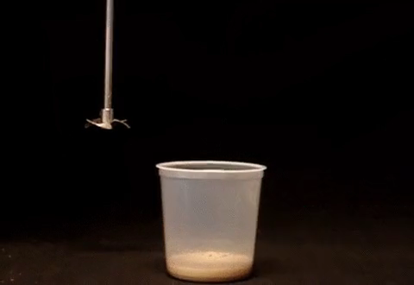
Yet Little is Known about the First 80 ms…
Polyol
Isocyanate
Polyurethane Foaming Reaction
Millisecond resolution
Water
0 s
Urea
Isocyanate
0.2 s
Polyol
0.9 s
Adapted from Machuga et al. 1988 AIChE J., 1057-64
Notes:
Millisecond resolution measurements are ideal for the time scale of bubble nucleation in polyurethane foaming.
“The mixed, interfacial region then continued to grow into the isocyanate phase”
With millisecond resolution measurements, we can uncover what’s going on between frames.
Bubble nucleation is especially fascinating in the foaming of thermoset polymers like polyurethane because foaming occurs alongside a reaction. To make polyurethane foam, isocyanate reacts with polyol to produce the cross-linked polyurethane structure of the foam. Simultaneously, isocyanate reacts with water to produce carbon dioxide and urea. The carbon dioxide is the “blowing agent,” which “blows” the foam. Despite the added complexities of continuous gas generation, solidification of the liquid phase, and heat released from the exothermic reaction, this foaming can produce very consistent insulating foam. Nevertheless, the bubble nucleation stage of polyurethane foaming is generally seen as a black box because observations have been too limited in spatial and time resolution to study nucleation. Micrographs from a 1988 study of polyurethane foaming in the Macosko group have shown that the polyol and isocyanate mix violently and move toward the isocyanate phase. We intend to look on the millisecond time scale to uncover what happens between the frames.

Slide 5
Visible-light Microscopy: Bubble Growth
Outer stream
SAXS
Inner stream
Outer stream
Notes:
We will use visible-light microscopy to observe bubbles larger than 1 um. With this information, we can track bubble growth. With image-processing software, we will trace the bubbles and measure their size for analysis. Additionally, we will determine where to probe with SAXS based on which point bubbles can first be seen with visible light. SAXS will be most effective before that point.

Slide 6
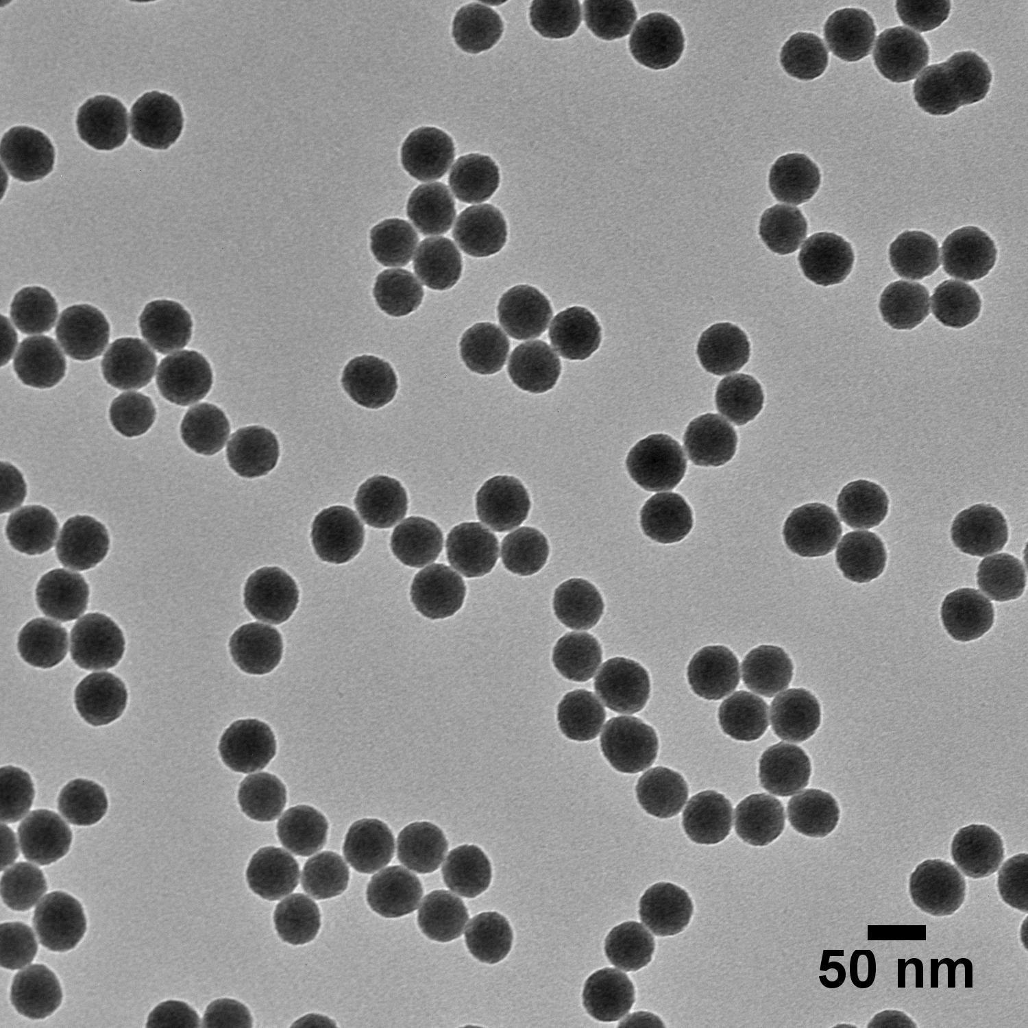
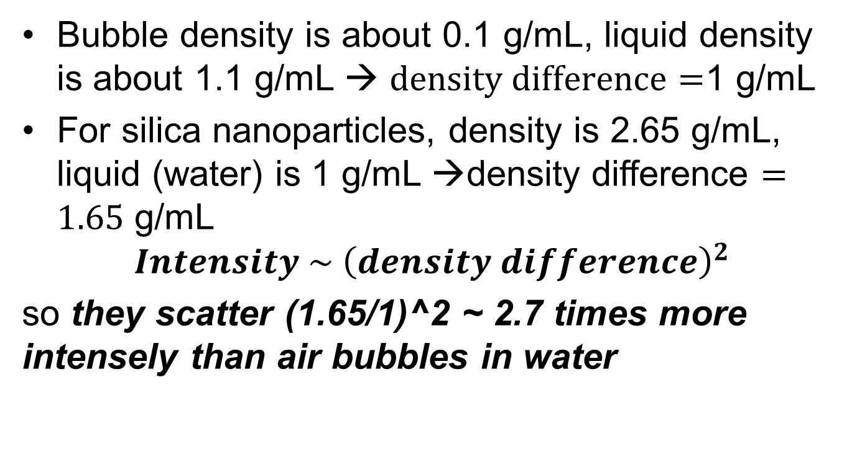
Nanoparticles vs. Bubbles
500 μm
Cao, X. et al. 2005, Polymer 46, 775-783
Bubble density is about 0.1 g/mL, liquid density is about 1.1 g/mL → $density difference=$1 g/mL
For silica nanoparticles, density is 2.65 g/mL, liquid (water) is 1 g/mL →density difference $=1.65$ g/mL
$$Intensity \sim {\left(density difference\right)}^{2}$$
so they scatter (1.65/1)^2 ~ 2.7 times more intensely than air bubbles in water

Slide 7
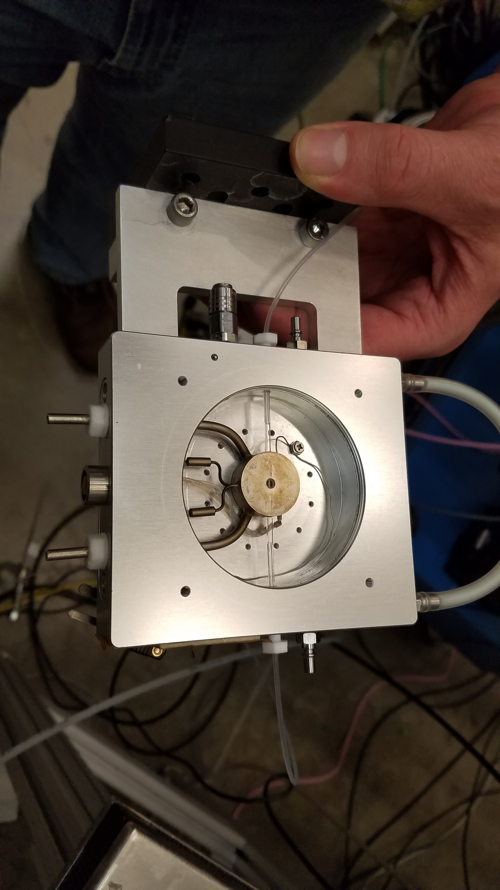
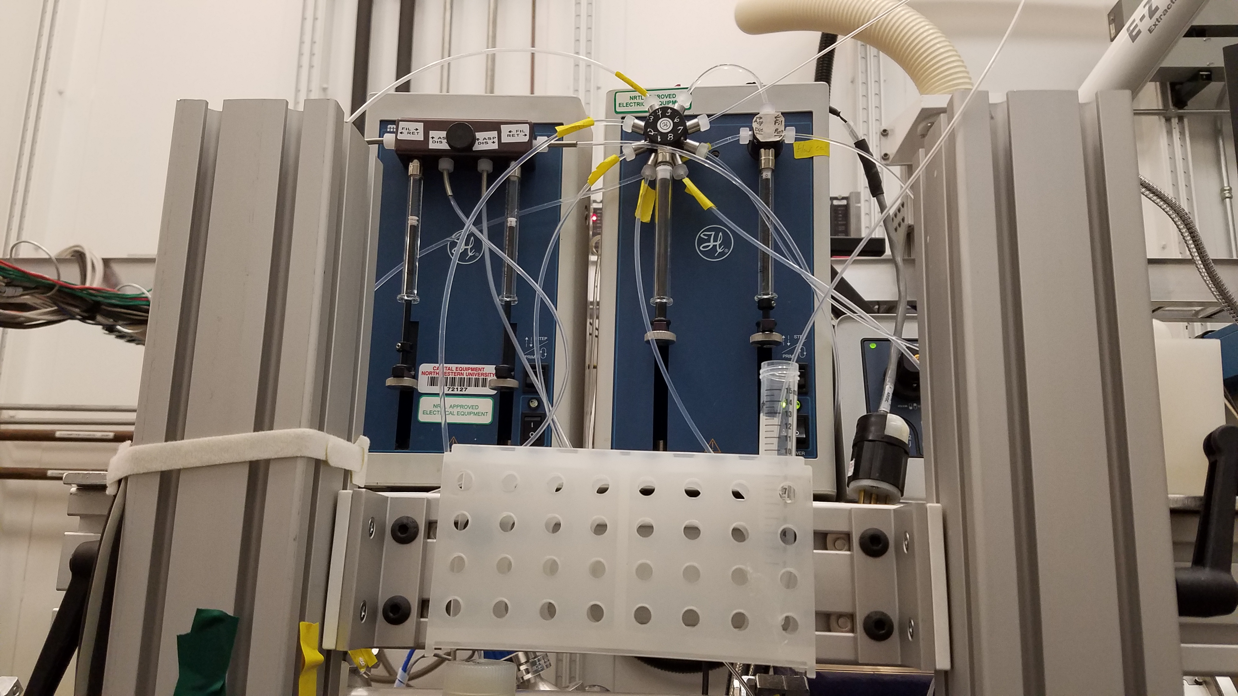
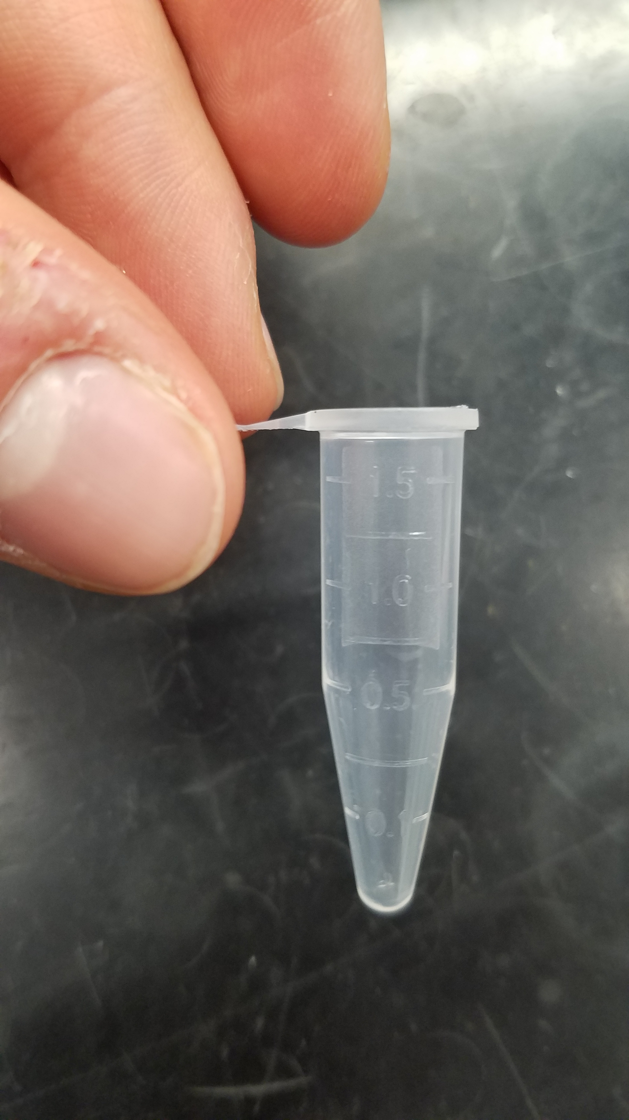
Flow Cell Experiment
Syringe pump system to load and dispense samples
Linkam stage flow cell (opened to view interior)
8-way sampling valve
X-rays pass through here
Waste
Quartz microfluidic channel (wall thickness 10-20 um, charlessupper)
Heater (not used)
Syringes (only used rightmost syringe)
Inlet/outlet (for both waste and refilling with sample)
Samples were loaded from 1.5 mL microcentrifuge tubes

Slide 8
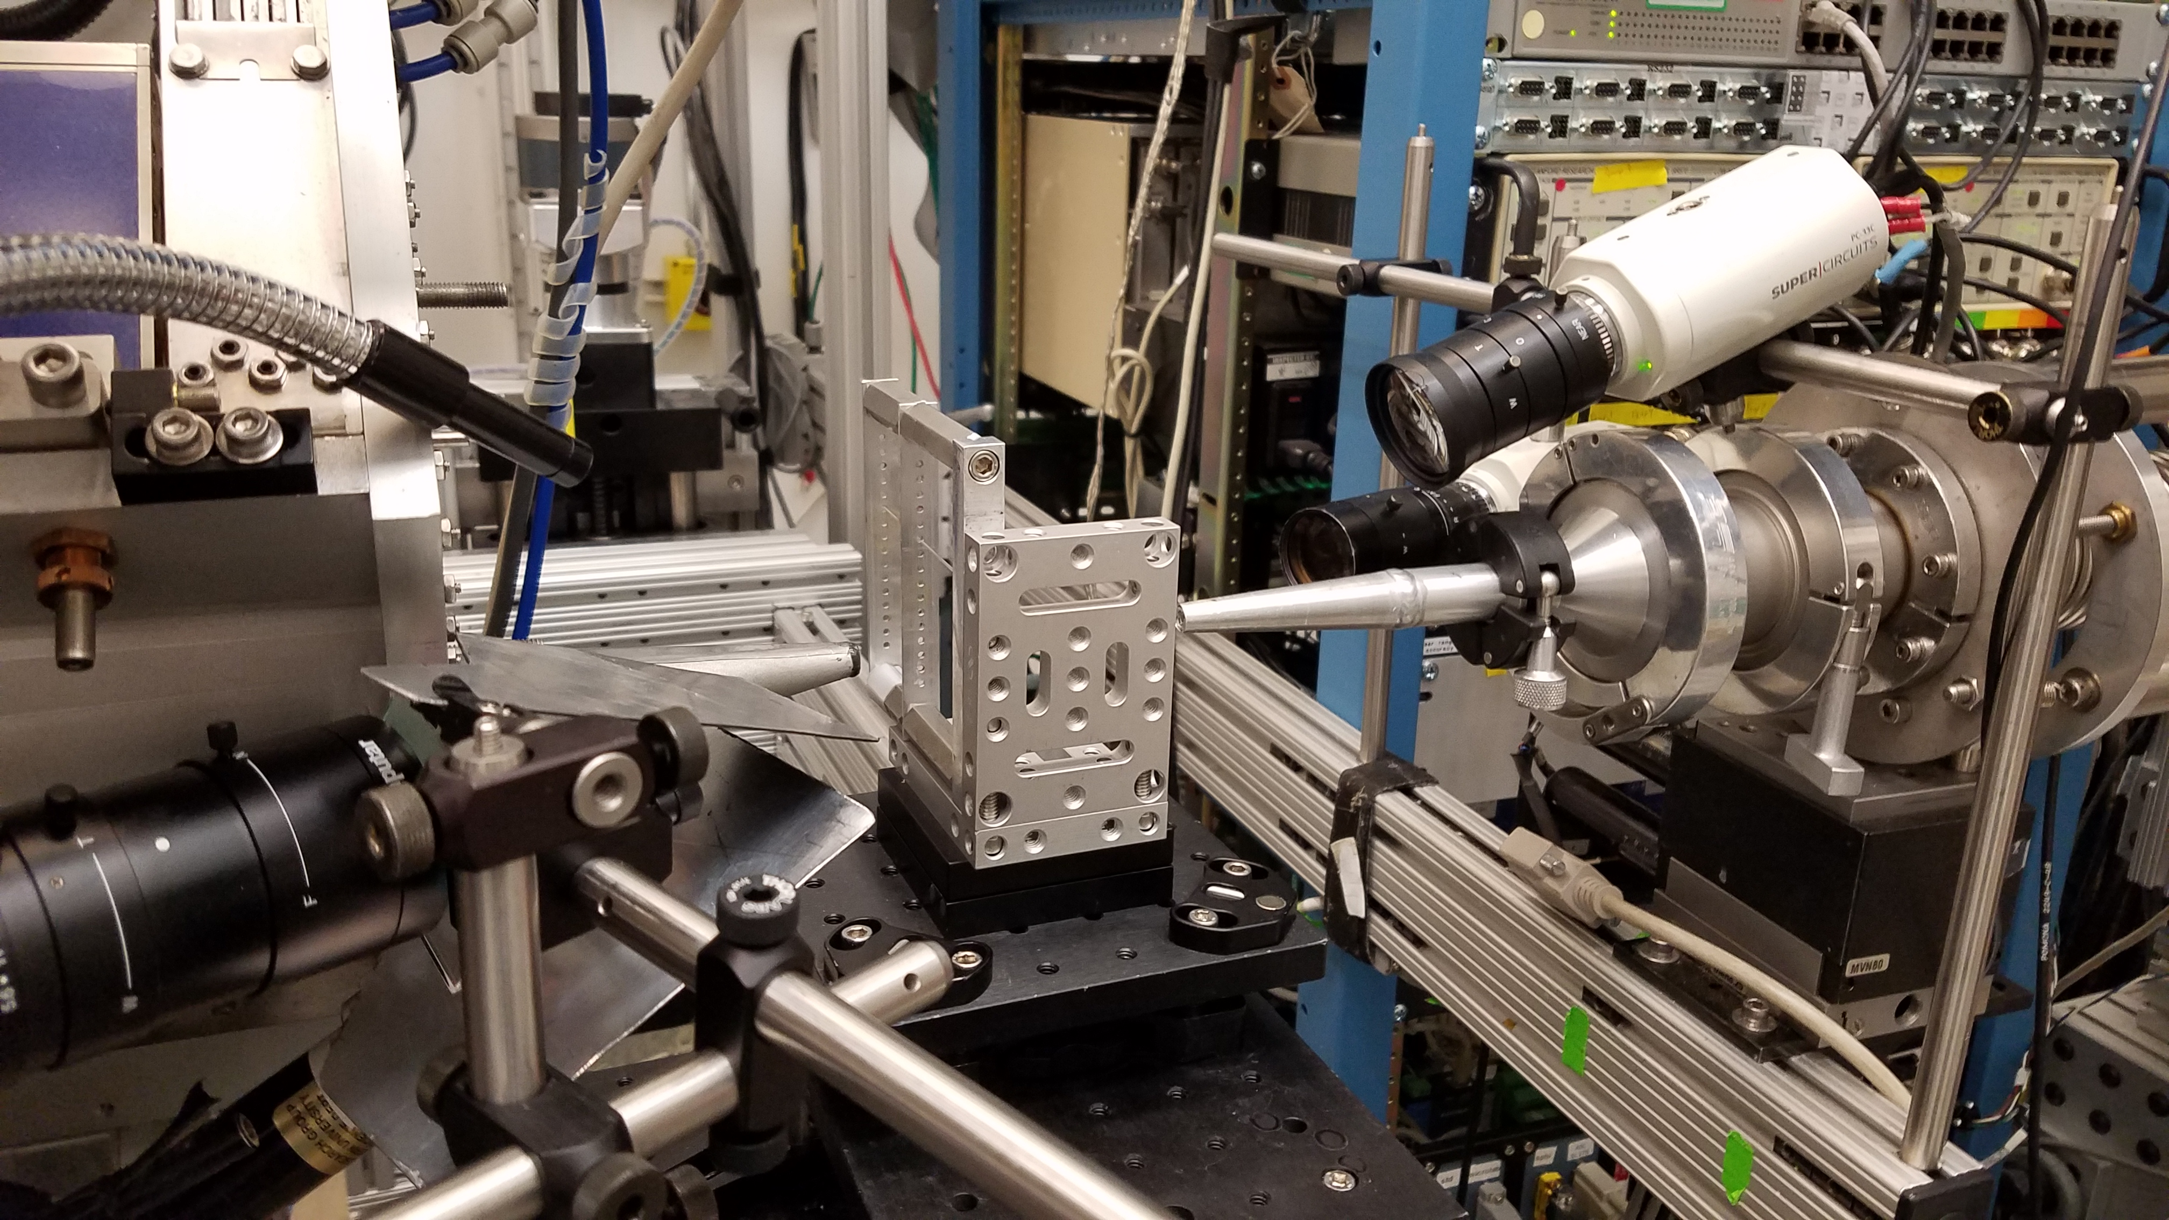
Beamline Setup
Channel 4 camera
Sample mount (capillary*)
Channel 3 camera
Incoming X-rays
Outgoing X-rays
Translation stage

Slide 9
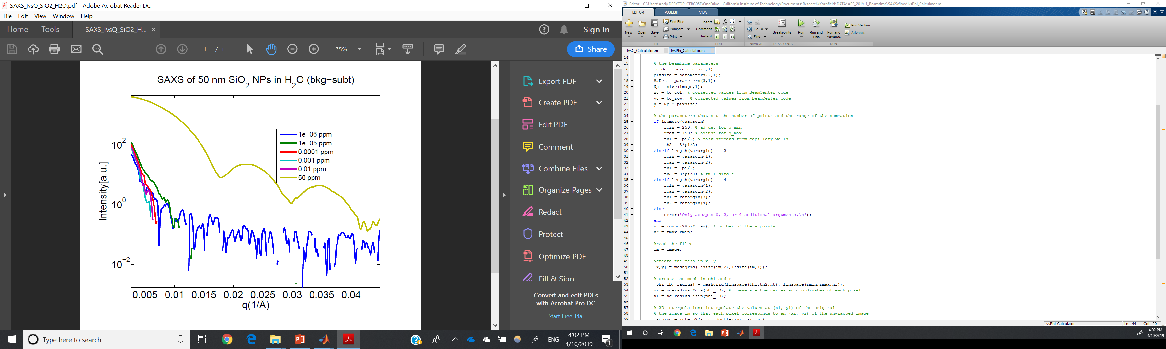
Comparison of Scattering at Different Concentrations
*Nanoparticle signal only clear for 50 ppm
^Subtracted background of pure water in quartz flow cell
Nanoparticle signal only clear for 50 ppm
3 characteristic peaks can be discerned
Not sure why signal is below noise for q > 0.04 / A
Notes:
Binning 2,4,4 (WAXS, MAXS, SAXS)
Exposure time of 3 s
Beam energy of 17 keV

Slide 10
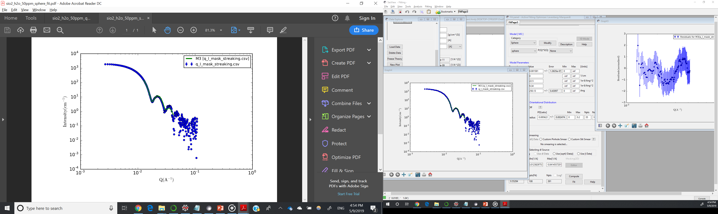
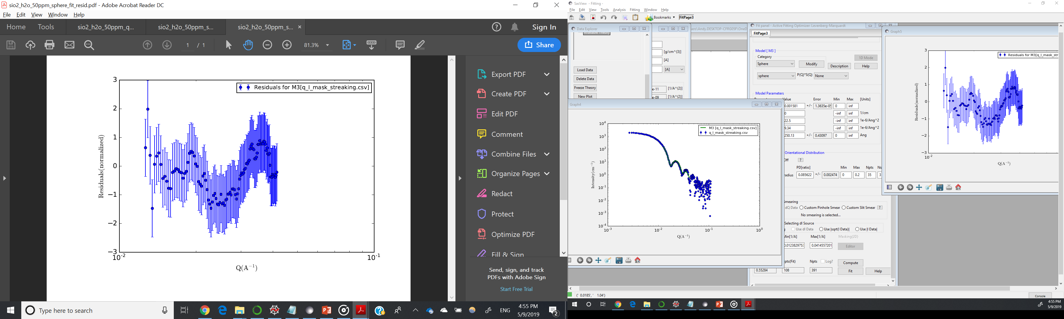
Fitting Masked Signal*
Parameter | Value
Scale | 1.581 +/- 0.014 e-3
Scattering Length Density (SLD) of SiO2 NPs | 22.5e-6 / A^2
SLD of H2O solvent | 9.43 e-6 / A^2
Radius | 250.1 +/- 0.4 A
Polydispersity ratio (sigma/mean) | 0.086 +/- 0.002 (Gaussian)
Q range | 0.0124 – 0.0415 / A
Reduced Chi2 | 0.553
Almost matches the measured values!
Mean radius = 250 A
Polydispersity ratio = 0.06
*Using SASView with guidance from Rachel Ford
Notes:
Measured values: Radius = 250 nm, polydispersity ratio is 0.06
***WANT TO TEST LARGER NANOPARTICLES AS SUGGESTED BY WEIJUN FOR LARGER SIGNAL (or at least see how signal scales)

Slide 11
Proposed Plan
Analyze X-ray intensity from study of silica dioxide nanoparticles to estimate the lowest concentration at which we can detect a signal
Calculate how the intensity of X-rays changes with the thickness of the tube
Calculate how the intensity of X-rays changes with the size of the nanoparticles

Slide 12
Graphs
Star = signal
Arrow = size of “noise”
Variables
Concentration of particles
Thickness of tube
Size of particles
Change 1, fix 2
Legend:
Height of plateau
Height of first peak
Height of second peak
Size of “noise” (variation) at each location
Intensity of X-rays
Changing variable

Slide 13
Key Skills to Learn
How do you quantify “noise”/variation in intensity?
How do you isolate the “signal” from the “background?”
How you plot the results clearly while changing different variables?

Slide 14
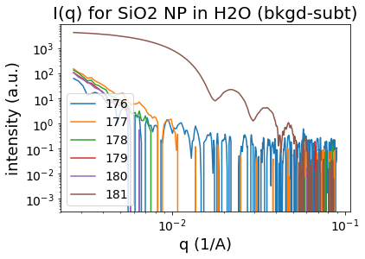
Assignment 1
Young’s Double Slit (https://www.khanacademy.org/science/physics/light-waves/interference-of-light-waves/v/constructive-and-destructive-interference)
Write a method in Python to extract data from “nanoparticle_scattering_data.csv” in the “flow” folder of “internship” folder
Reproduce this plot (background-subtracted intensity vs. q) for all concentrations besides 0 ppm (parts per million)

